Slide 1
Carpe Ludum
By Samuel Benardo

Slide 2
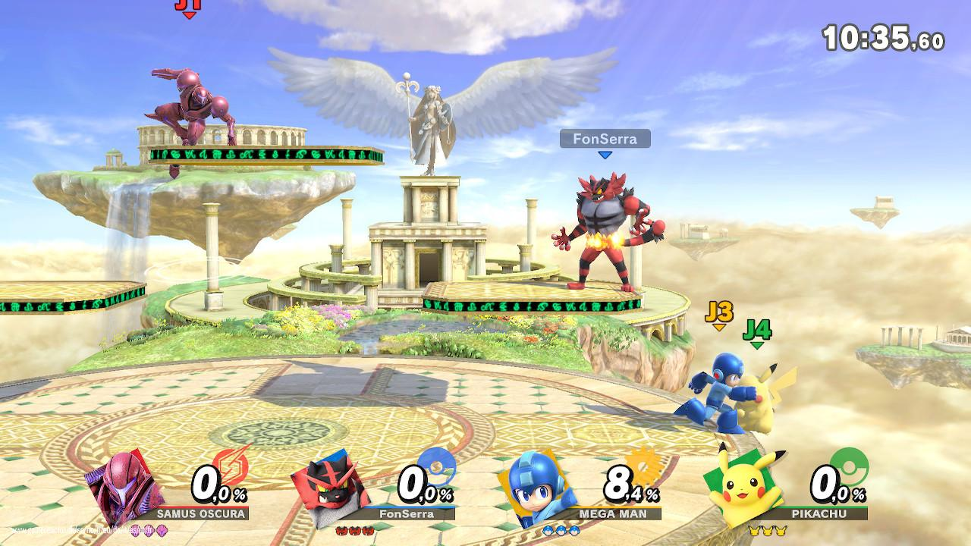
The Core Concept
Super Smash Bros like game where the map is generated off of an image
Characters, items, and the battlefield are up to the players imagination
The crux of this idea, and the main appeal of the game, is that its scope and enjoyability is limited only by the imaginations of the users.

Slide 3
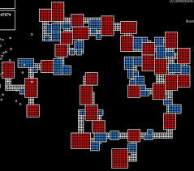
Character and Map Generation
Certain items on screen are marked as playable characters, whose moveset, movement, and stats are either AI generated or player generated (stat sum limits are placed on player made stats)
Giving certain objects in the screenshot physics lets the map change in real time
map and character variations and possibilities are infinite
can be shared simply by sharing screenshots
You can play in ANYTHING as ANYTHING
maps and characters can be saved
saved character can then be reused in a new map and game depending on what the players agree on for that game

Slide 4

Controls and Settings
W (jump) A (move left) S (character ability) D (move right) SPACEBAR (another ability) SHIFT (another ability)
players can agree to share their chosen mechanics, and have the game inform them of the properties of the map, or to keep it all a mystery
Players can choose all sorts of settings from player count to the way the game is set up

Slide 5

Secondary Goal
playable in class considering phone ban
Button that immediately switches the screen back to link of users choice
auto-pauses the game (this can be disabled if the opponent abuses the feature in non-urgent situations)

Slide 6

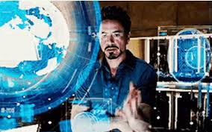
Potential Additional Features
leaderboard, ranking, and tournament feature
mobile version, replace the controls with a joystick and tappable buttons
let players program their own characters and import into the game (with safeguards in place that ensure when the code is dysfunctional, the game does not break)
bossfight, or infinite rounds mode, players work together to defeat generated enemies (also generated from the screenshot)
Screen recordings, now the map is constantly changing
concepts are secondary and only build off of the base game idea since it is so versatile

Slide 7
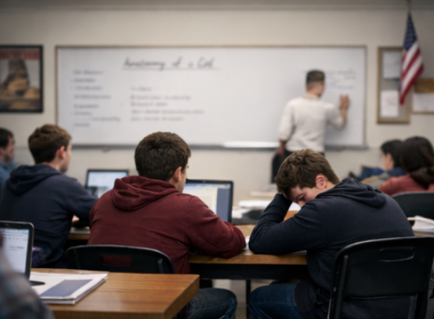
For example…
Three friends sit in separate corners of a classroom. The teacher is lecturing the most boring topic imaginable, and students are taking notes on google docs. With just a glance, the three know what to do. All three students open the app on their computer while one screenshots their google docs page and starts a lobby in the game.

Slide 8
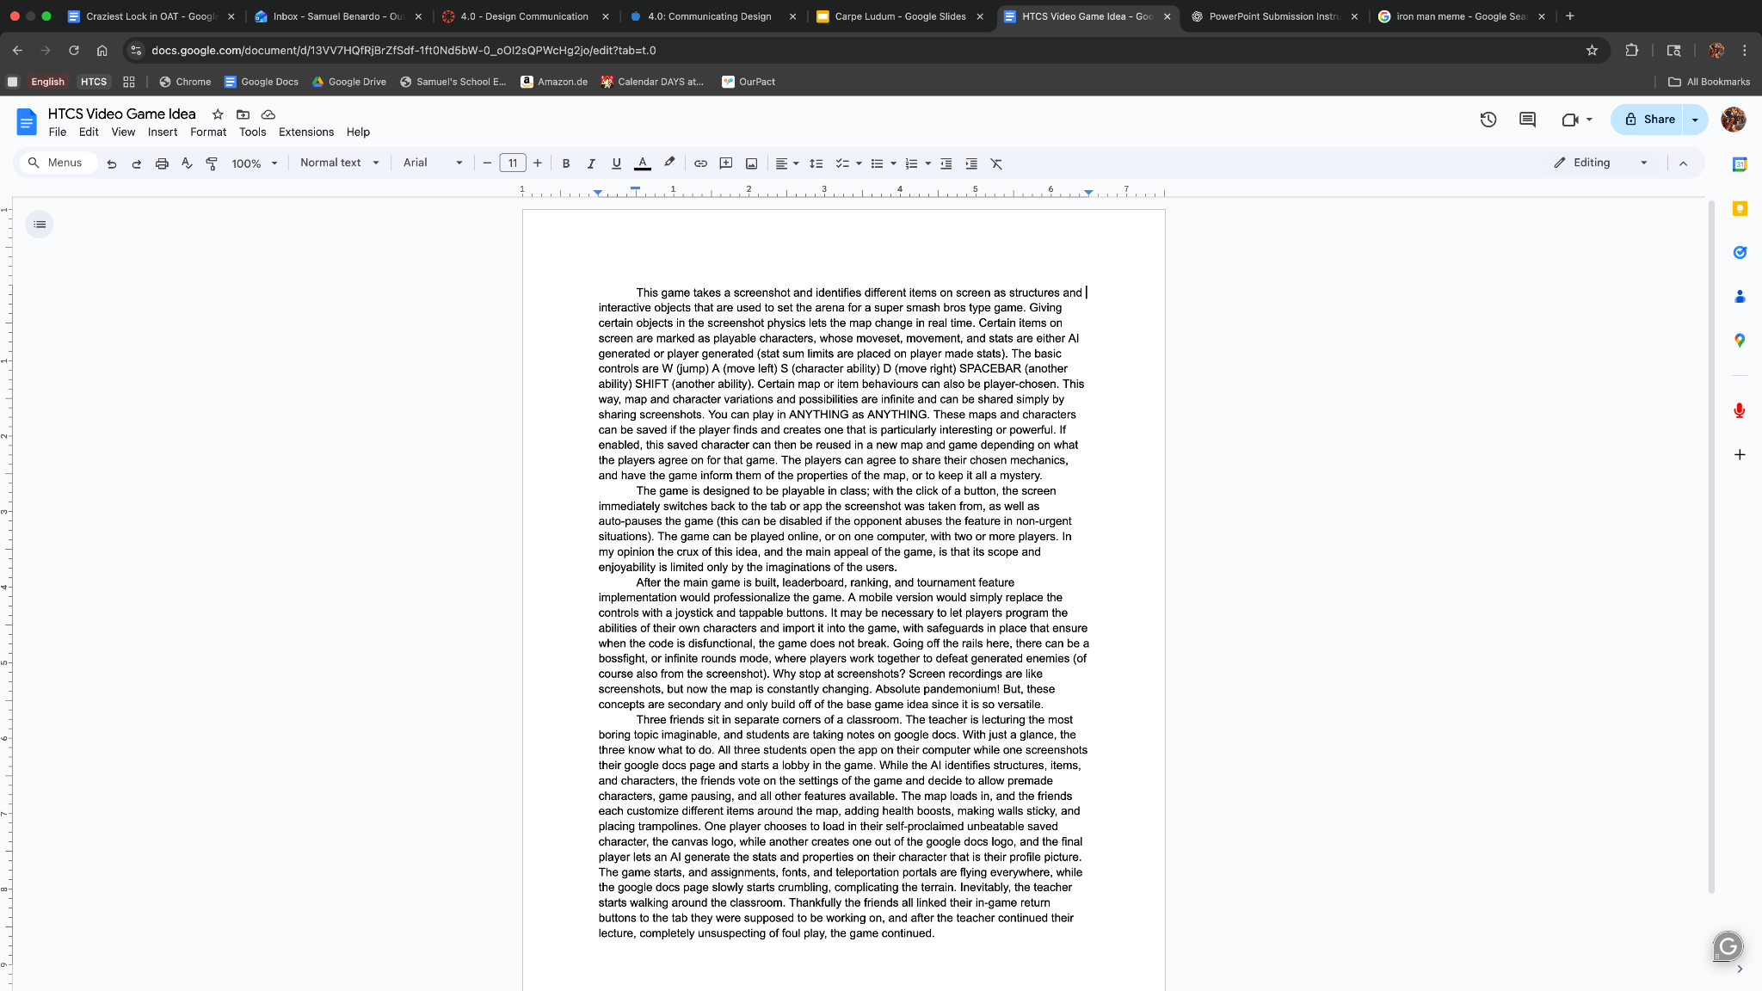
For example…
While the AI identifies structures, items, and characters, the friends vote on the settings of the game and decide to allow premade characters, game pausing, and all other features available. The map loads in, and the friends each customize different items around the map, adding health boosts, making walls sticky, and placing trampolines. One player chooses to load in their self-proclaimed unbeatable saved character, the canvas logo, while another creates one out of the google docs logo, and the final player lets an AI generate the stats and properties on their character that is their profile picture.

Slide 9

For example…
The game starts, and assignments, fonts, and teleportation portals are flying everywhere, while the google docs page slowly starts crumbling, complicating the terrain. Inevitably, the teacher starts walking around the classroom. Thankfully the friends all linked their in-game return buttons to the tab they were supposed to be working on, and after the teacher continued their lecture, completely unsuspecting of foul play, the game continued.

